Slide 1

11252021
Will blockchain change the world ?
Arthur Levoir
Thomas Sadurni

Slide 2
Presentation
Plan
1
Technology
Background
Blockchain
POW/POS
Cryptocurrencies
What is a Cryptocurrency?
Bitcoin
What about others Cryptocurrencies ?
To go further
DeFi
NFT
Stablecoins
Pros and cons
2
3
Page

Slide 3
Presentation
Plan
1
Technology
Background
Blockchain
POW/POS
Cryptocurrencies
What is a Cryptocurrency?
Bitcoin
What about others Cryptocurrencies ?
To go further
DeFi
NFT
Stablecoins
Pros and cons
2
3
Page

Slide 4



Background
Technology
1991
2008
Stuart Haber and Scott Stornetta theorized a system where document timestamps could not be tampered with
Satoshi Nakamoto writes the whitepaper detailing Bitcoin
(must read)
Page

Slide 5



Background
Technology
2009
2010
2011
Bitcoin is released
The first ever purchase using Bitcoin occurs
Bitcoin’s value passes the $1 threshold
Page

Slide 6
Background
Technology
2021
Bitcoin ATH : $69000
2013 - 2017
Bullrun brings price to $20000
Bitcoin’s value is hovering around $1000
value
$1000
Page
time

Slide 7


Blockchain | Definition
Technology
A blockchain is a growing list of records, called blocks, that are linked using cryptography.
Wikipedia, Blockchain
Page

Slide 8


Blockchain | Hash Function
Technology
Hash Function
File (Input)
Hash value (Output)
Page

Slide 9
Blockchain | Data Structure
Technology
BLOCK 10000
BLOCK 10001
BLOCK 10002
Hash block 9999
Hash block 10000
Hash block 10001
Data (transactions)
Data (transactions)
Data (transactions)
Hash block 10001
Hash block 10002
Hash block 10003
Page

Slide 10
POW/POS | Definition
Technology
Proof of Work and Proof of Stake are consensus mechanisms, and they represent a requirement to confirm transactions that take place on a blockchain, without needing an intermediary.
bitdegree.com
Page

Slide 11
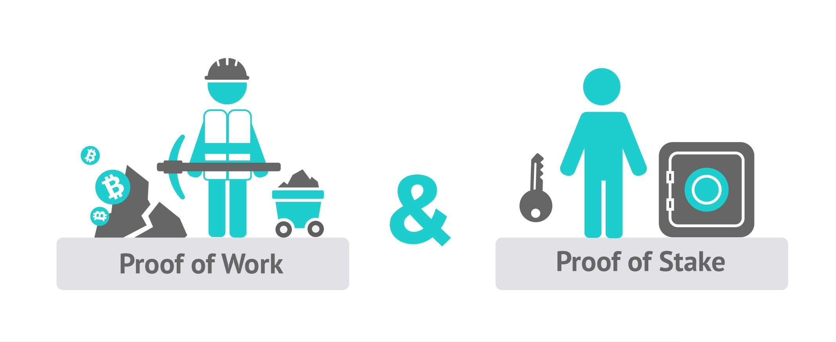
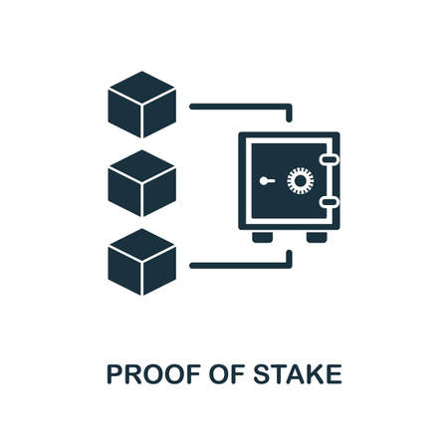
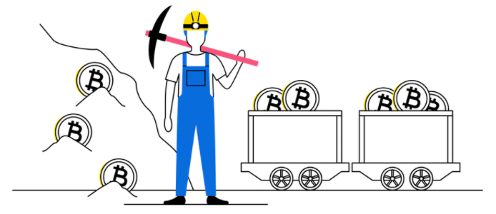
POW/POS | vs
Technology
Proof of Work
Proof of Stake
First to resolve the problem wins
The more pieces you have the more chance you have to win
Cryptographic algorithm : 8 + 2
Context : To validate transactions on the Avalanche network, you will need to stake and freeze at least 2000 Avax coins
Miner 1, Miner 2, Miner 3 … Miner N
Miner 1 : 12 ; 8 ; 10
Miner 2 : 14 ; 20 ; 8
Miner 3 : 5 ; 9 ; 12
…
Miner N : 2 ; 34 ; 7
You have 4000 AVAX coins
Miner 1 is the winner for this transaction
You now have a 3% chance of winning each reward.
First one to solve a mathematical problem wins
Need huge computing power
Use huge amount of energy
Slower
First one to solve a mathematical problem wins
Need huge computing power
Use huge amount of energy
Slower
Page

Slide 12
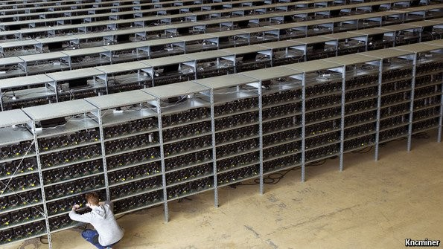
Mining farm
Technology
Bitcoin mining farm
Page

Slide 13
Presentation
Plan
1
Technology
Background
Blockchain
POW/POS
Cryptocurrencies
What is a Cryptocurrency?
Bitcoin
What about others Cryptocurrencies ?
To go further
DeFi
NFT
Stablecoins
Pros and cons
2
3
Page

Slide 14
What is a cryptocurrency ?
Cryptocurrencies
Right now Cryptocurrencies feel like the internet before the browser.
Bitcoin will do to banks what email did to the postal sector.
Page

Slide 15
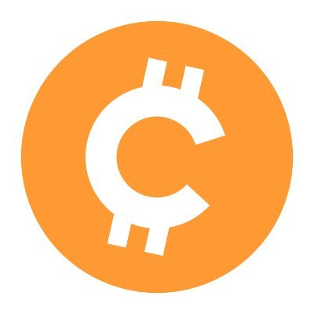

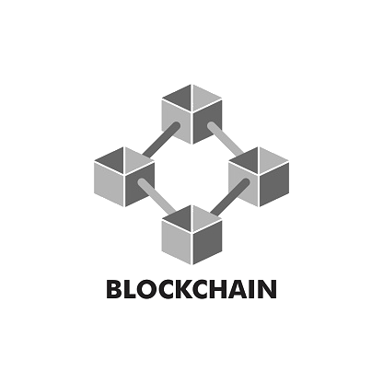

What is a cryptocurrency ?
Cryptocurrencies
Cryptocurrency in some words
Base on blockchain technology
“Cryptocurrency” derived from encryption (security)
Difficult to replicate
Easy to exchange
Divisible
Inflation resistant
Transparent
Page

Slide 16
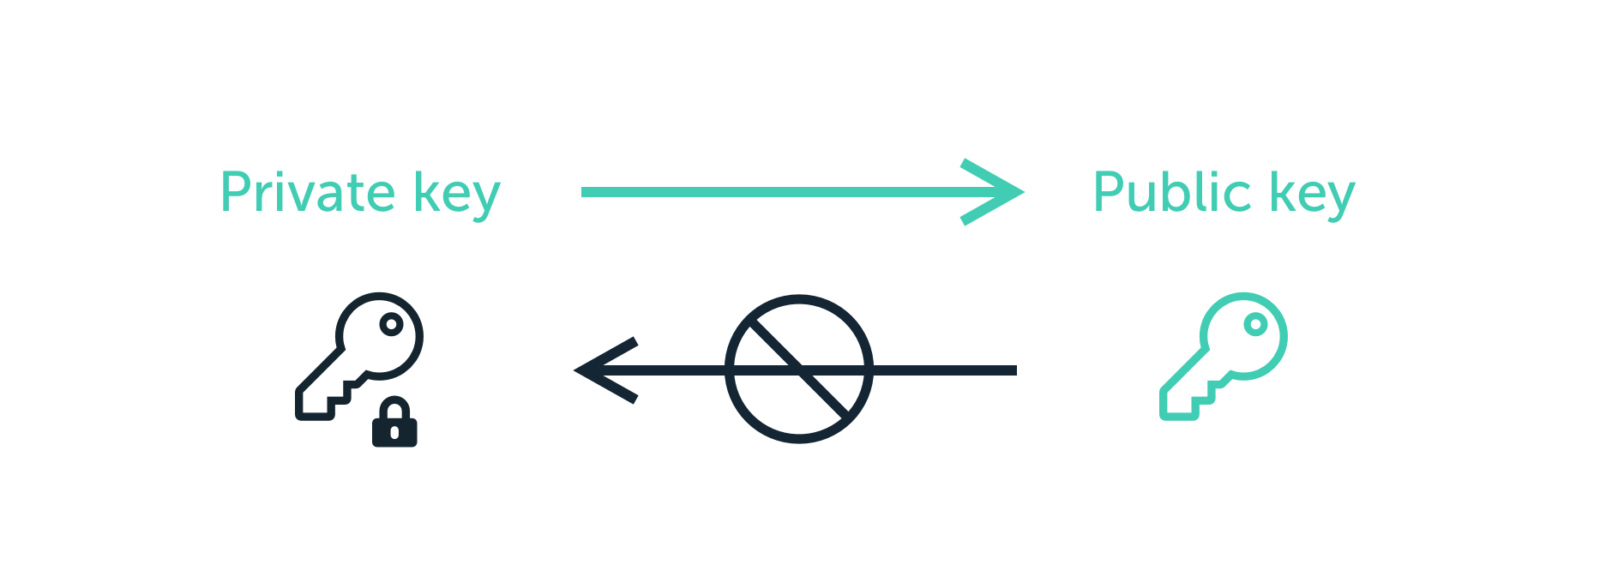
What is a cryptocurrency ?
Cryptocurrencies
97b10642647d0ad6762b6cedb30e5bf1ae5412995d92fe2fc20aa352e8440081
0xa712D630407c01df10d40519fCEfdAae1098cc19
Wallet address
(i.e bank account number)
Required to make transactions
(i.e ATM PIN)
Page

Slide 17


Bitcoin
Cryptocurrencies
100% VIRTUAL Based on trust
90% VIRTUAL Based on trust
90% VIRTUAL Based on trust
Page

Slide 18
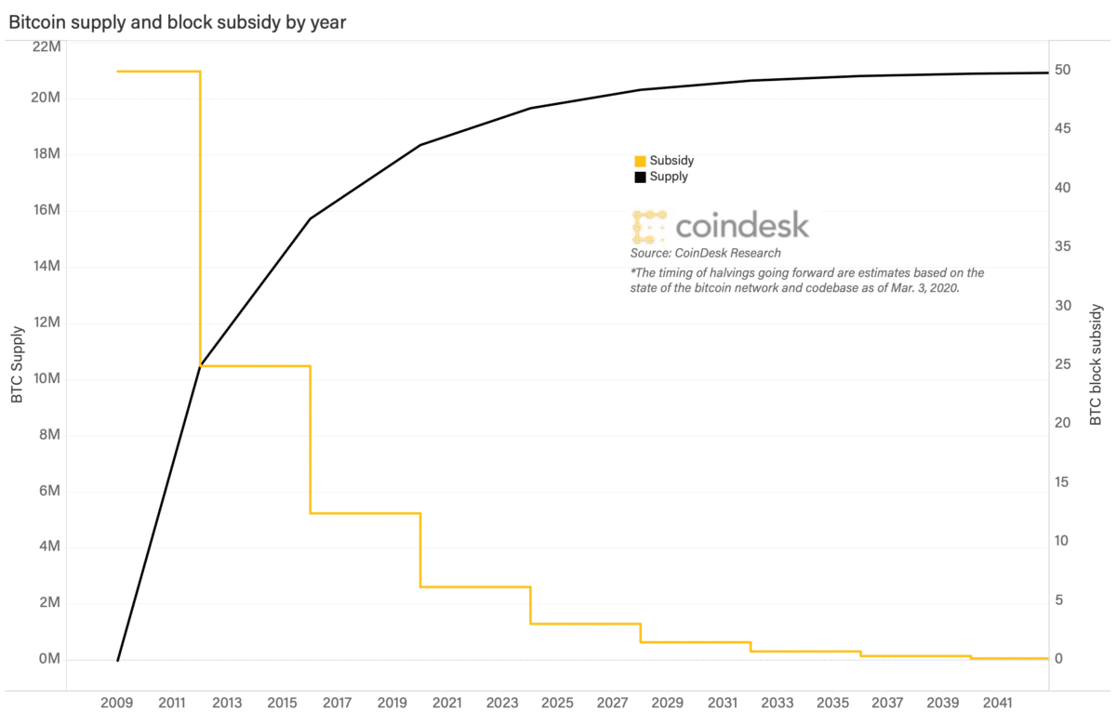
Bitcoin
Cryptocurrencies
Page

Slide 19




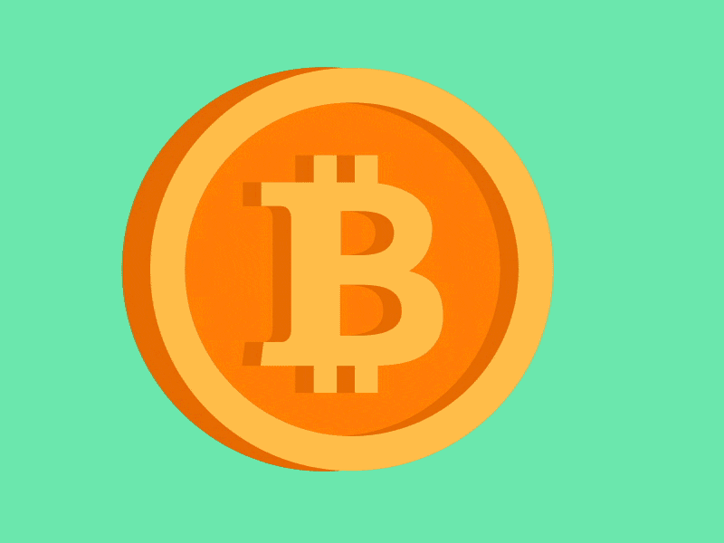


What about others Cryptocurrencies ?
Cryptocurrencies
Is there only Bitcoin ?
Page

Slide 20
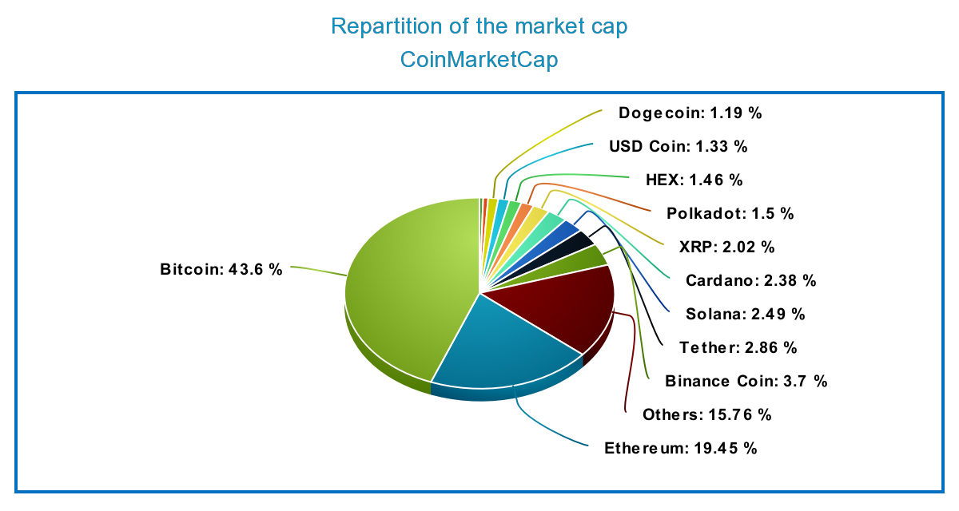
What about others Cryptocurrencies ?
Cryptocurrencies
Page
Market Cap = Price * Circulating supply

Slide 21
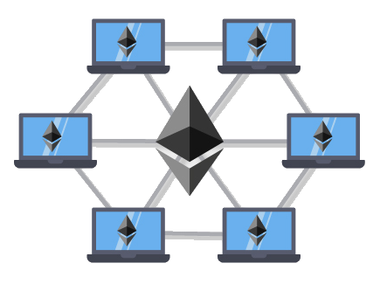
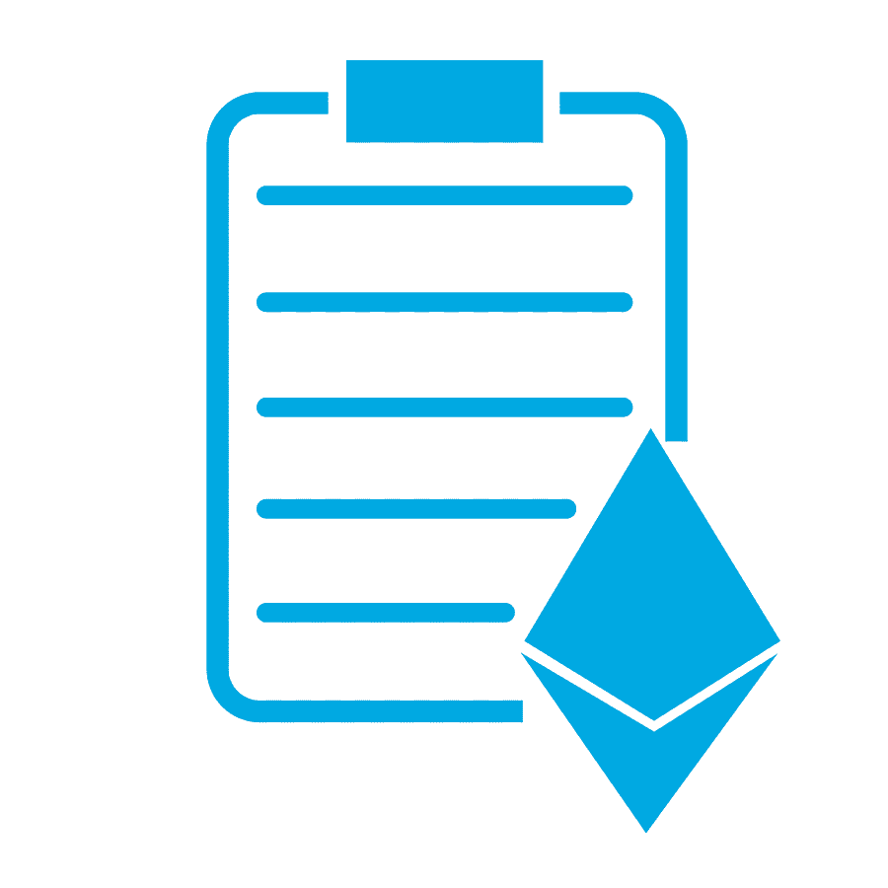
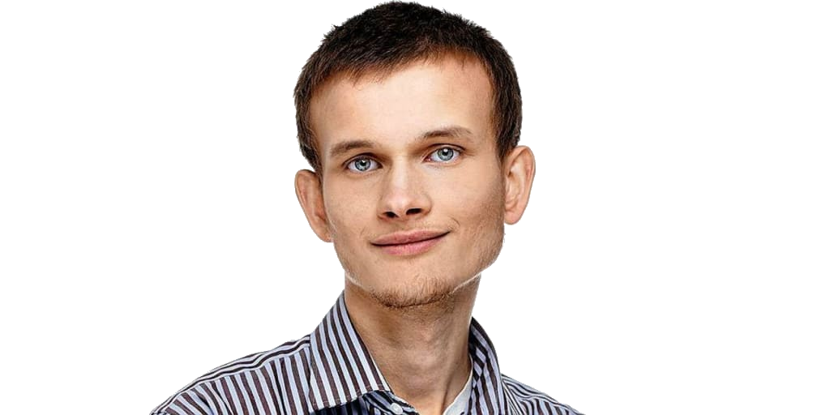





What about others Cryptocurrencies ?
ETHEREUM the revolution
Trackable
Permanent
Transparent
Vitalik Buterin
Ethereum Virtual Machine
First Smart Contract blockchain
Decentralized Application
Page

Slide 22



What about others Cryptocurrencies ?
ETHEREUM 2.0, the game changer ?
Upgrading Ethereum to radical new heights
ETH
ETH 2.0
Low fees (~ <0.0001$)
100 000 transactions per second
Proof of Stake
More scalable
More secure
More sustainable
High fees (~ 15$)
15 transactions per second
Proof of Work
Small wallet
Layers 2
Page
Huge adoption of anyone
ETH flippening BTC ?

Slide 23
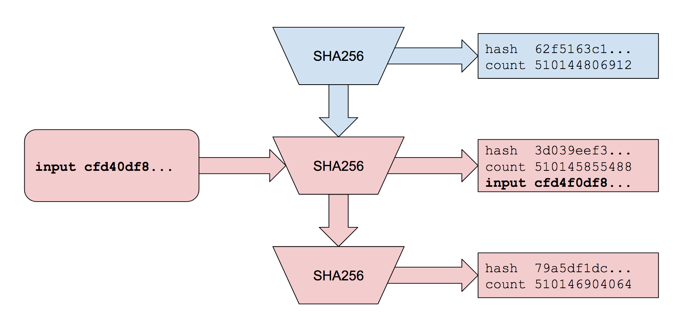


What about others Cryptocurrencies ?
SOLANA
Fastest blockchain : 50 000 tx per seconds (10x Visa)
Low fees (~ <$0.0001)
Proof of History
4th crypto in market cap
DEX
DeFi
NFTs
dApps
Proof of History
Page
Solanart : NFT marketplace

Slide 24
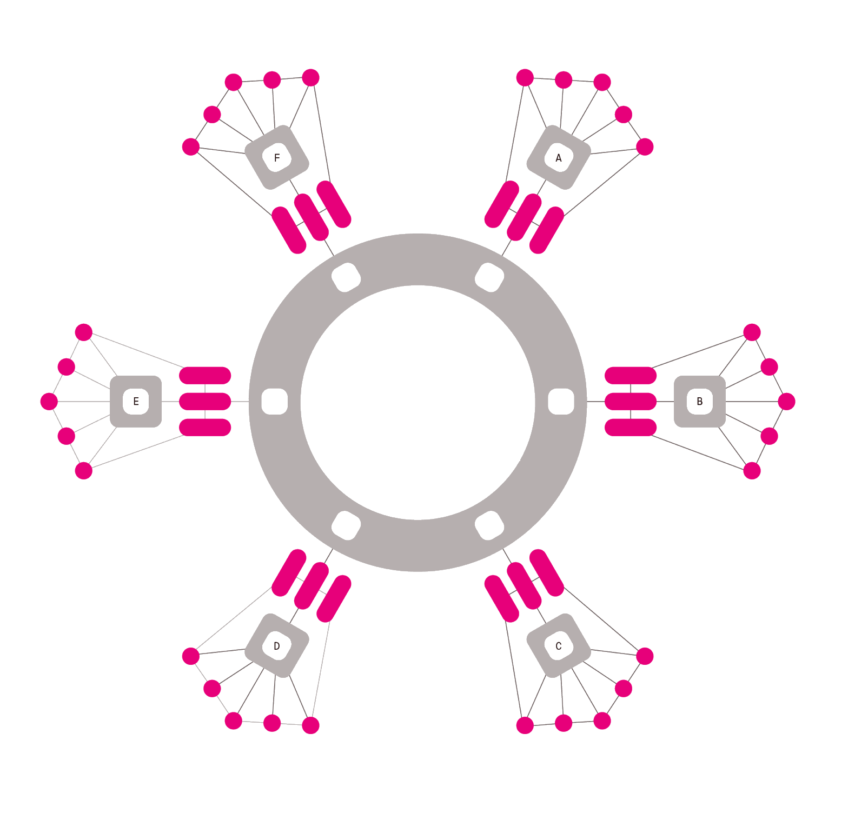
What about others Cryptocurrencies ?
POLKADOT, a layer 0 ?
Relaychain
Shared security
Interchain message passing
Parachain
Blockchain that has its own logic
Nominated Proof of Stake
Vote for a set of validators
Auction
Vote for a project to go live on the blockchain
Validators : validate the transaction and approve changes to the blockchain
Relaychain
Parachain B
Page

Slide 25

Shoutout to another cryptocurrency
Usages
 | BTC | ETH | DOT | SOL | VISA
TPS | 7 | 15 | 1000 | 50000 | 10000
Latency (s) | 600 | 98 | 5 | 2 | 3
Fees ($) | 3 | 50 | 0.001 | 0.0001 | 1.2%
Consensus | PoW | PoW | PoS | PoH | -
Market Cap (B$) | 1094 | 500 | 40 | 63 | -
Page

Slide 26
Presentation
Plan
1
Cryptocurrency ?
Background
Blockchain
POW/POS
Usages
What is a currency?
Comparison with Bitcoin
What about others Cryptocurrencies ?
To go further
DeFi
NFT
Stablecoins
Pros and cons
2
3
Page

Slide 27
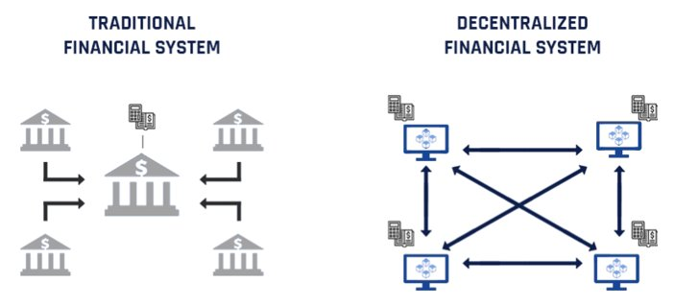
DeFi
To go further
“Decentralized finance (commonly referred to as DeFi) is a blockchain-based form of finance that does not rely on central financial intermediaries such as brokerages, exchanges, or banks to offer traditional financial instruments, and instead utilizes smart contracts on blockchains”
Wikipedia, DeFi
Page

Slide 28

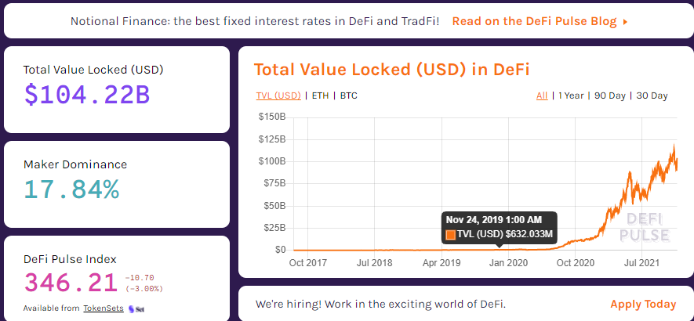
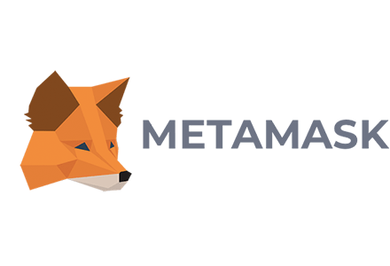

DeFi
To go further
APR
Main principles :
Uses Smart Contracts
Operates on decentralized infrastructures and blockchain
Exchanges, Insurrance
Lending / Borrowing and earn interests
Big APR
Natively digital
Open to all
0.5%
20%
Disadvantages :
Difficult to understand : use of metamask and Web 3.0
Hackers and bugs might empty your wallet
Metrics taken on defipulse.com
Page

Slide 29

NFT
To go further
Non Fungible Token
JPEG
NFT
Page

Slide 30
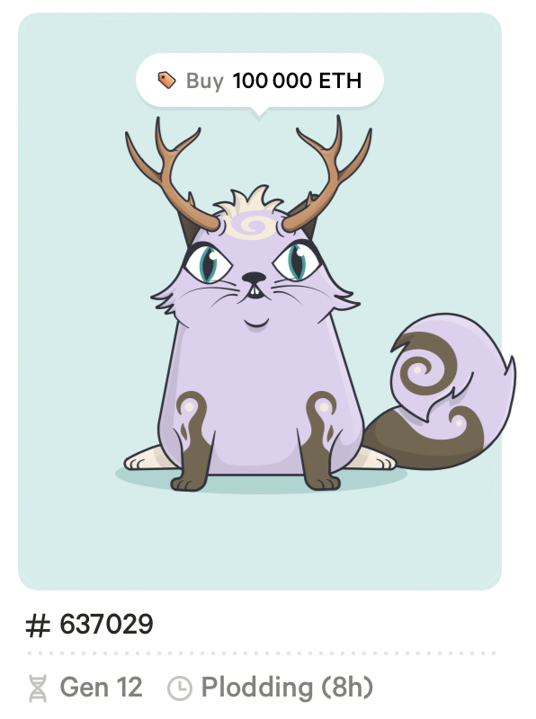

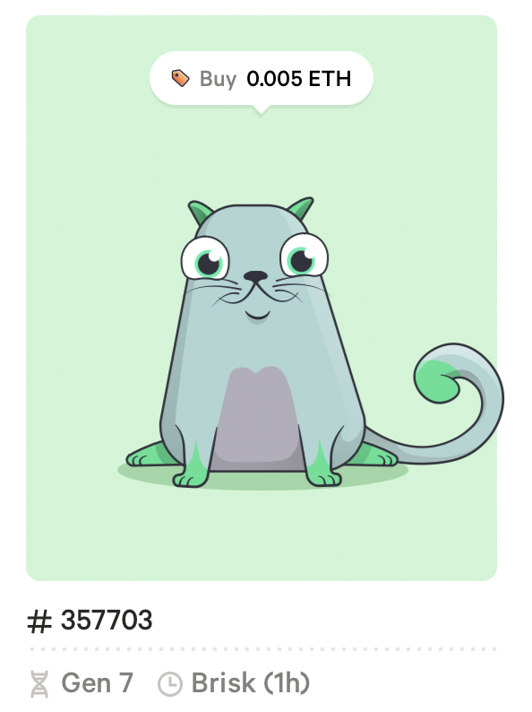
NFT
To go further
ERC 721
On the Ether Blockchain
2017 : Cryptokitties
Page

Slide 31
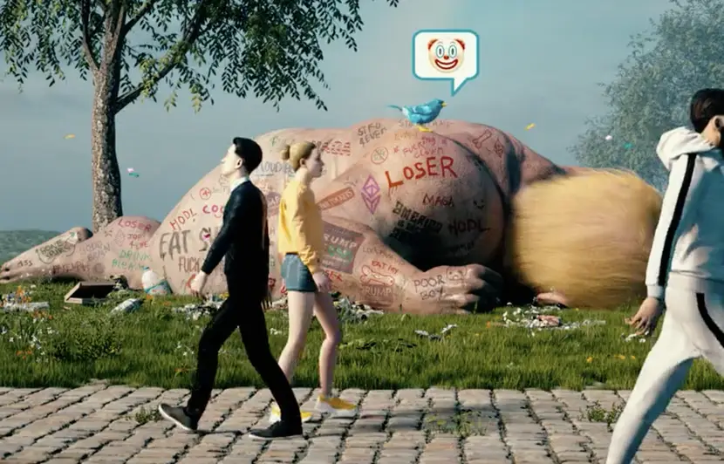

NFT
To go further
6.6M$
CROSSROAD is an NFT created by acclaimed digital artist Beeple that features anti-Trump messaging.
+100M$
CryptoPunks make up a number of the most expensive NFT sales.
They're a randomly generated set of 10,000 unique digital characters.
Page

Slide 32



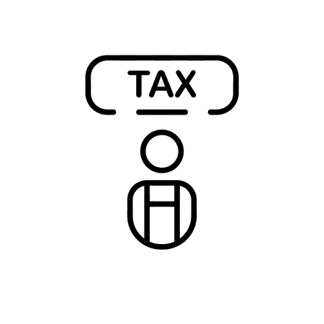
Stablecoins
To go further
A stablecoin replicates the value of a real world asset :
2016
2021
3 days
3 days
Immediate
Page

Slide 33
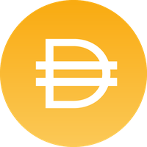



Stablecoins
To go further
3 types of stablecoins
Centralized Collateralization
Collateralization in Cryptocurrencies
Algorithmic stablecoins
$1B in bank accout
1B $Dai
$1.5B in Smart Contract
1 $UST
-1$ of $Luna
1B $USDC
Page

Slide 34


Pro and cons
To go further
Pros
Cons
Challenges of market fluctuations
Unparalleled transparency
Instant and 24h accessibility
No security in case of loss
Absolute anonymity
Not mainstreamed yet
Page

Slide 35
Question
What do you think ?
Do you think cryptocurrencies will surpass or even replace traditional currencies ?
Page

Slide 36
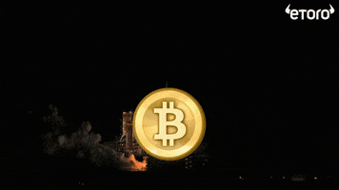
Question
Any question ?
Thank you !
#HODL
Page

